Slide 1
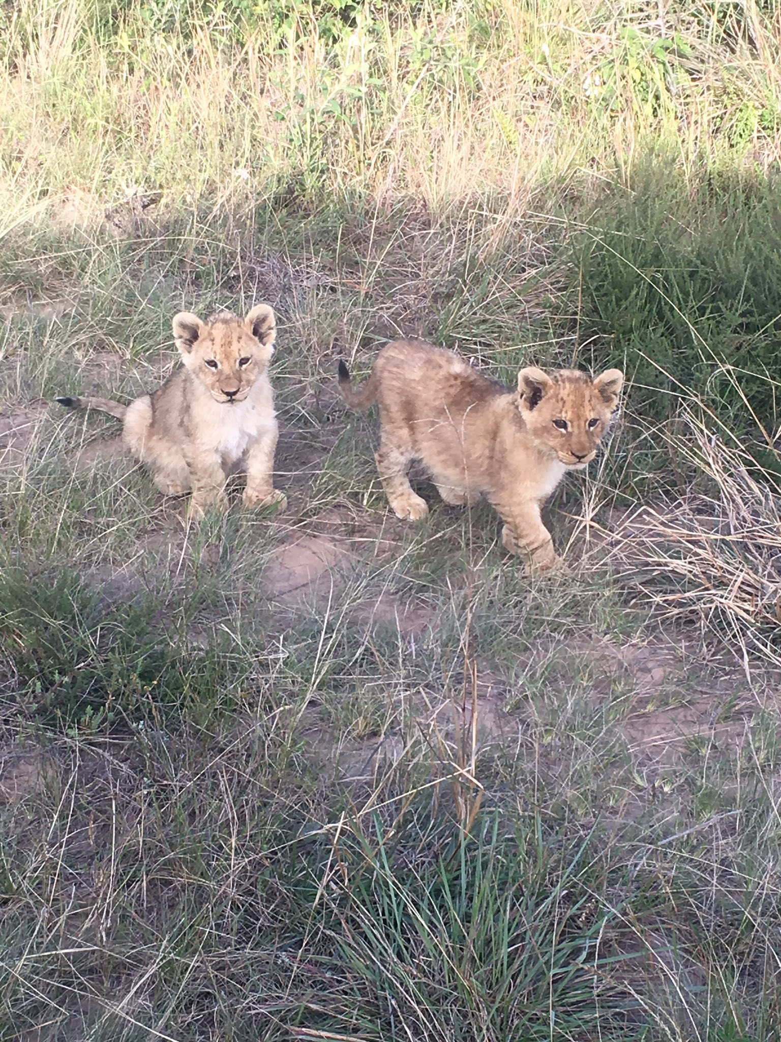
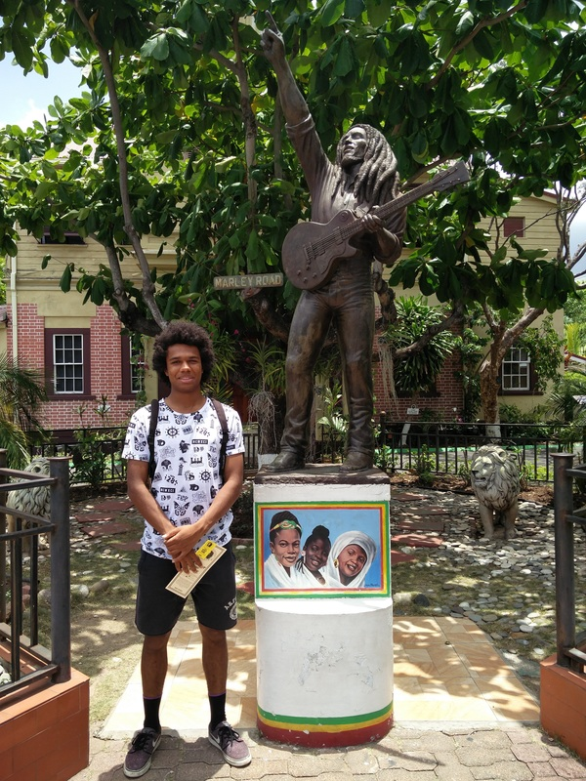
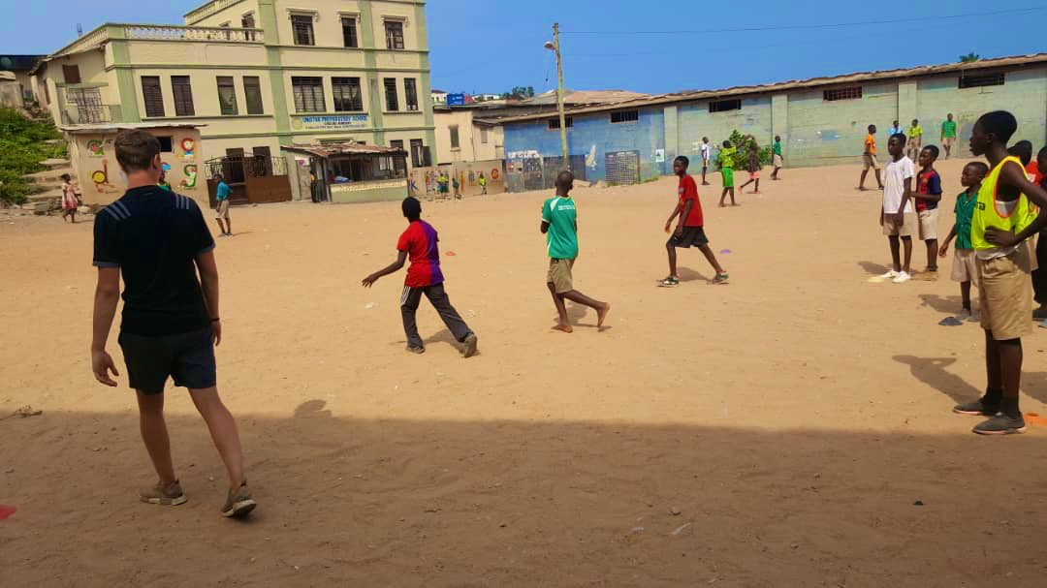
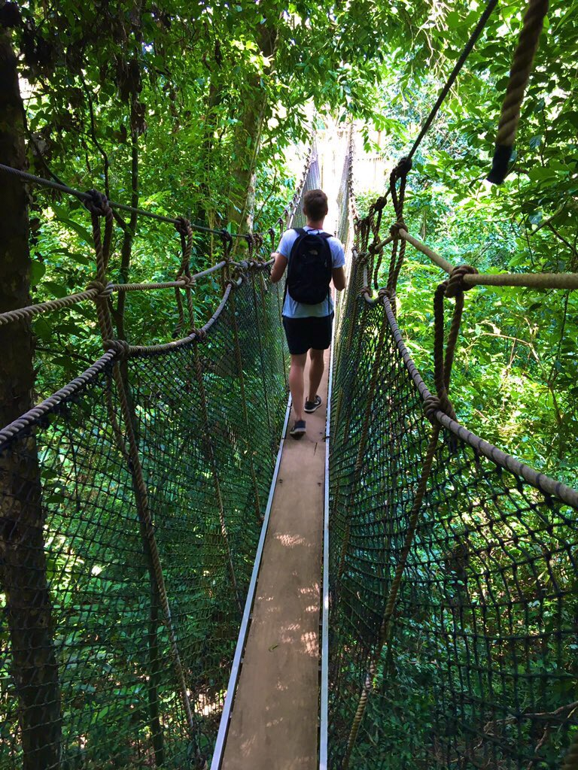
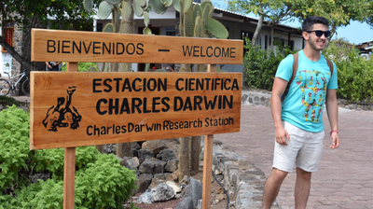
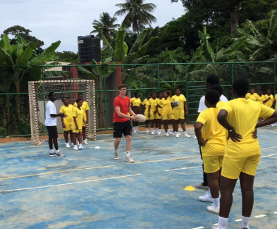
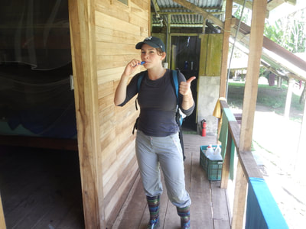
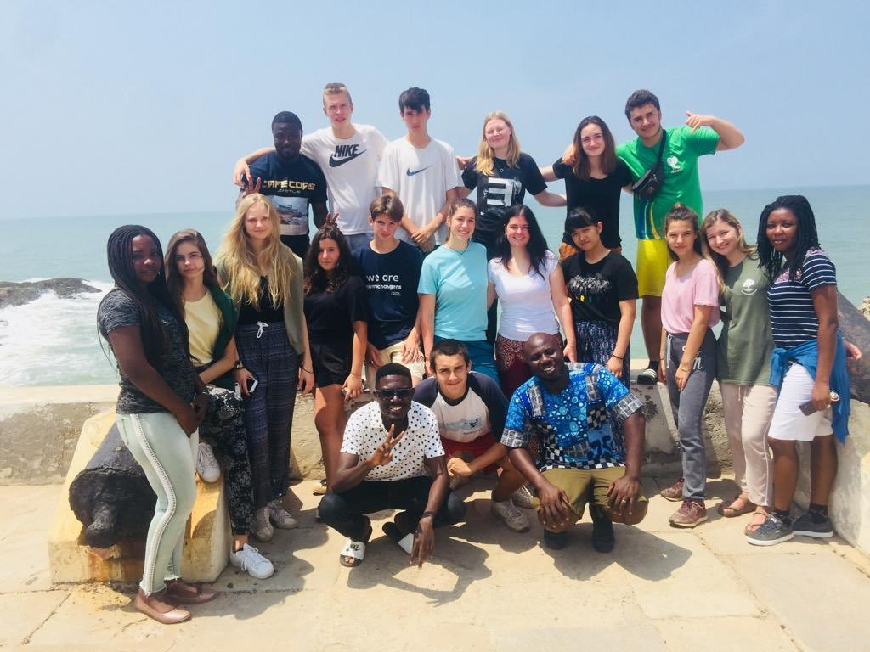
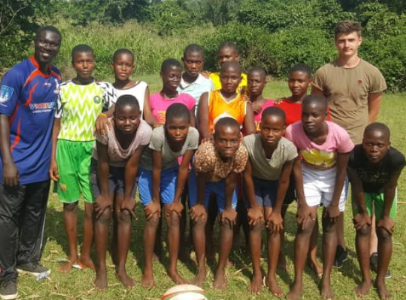
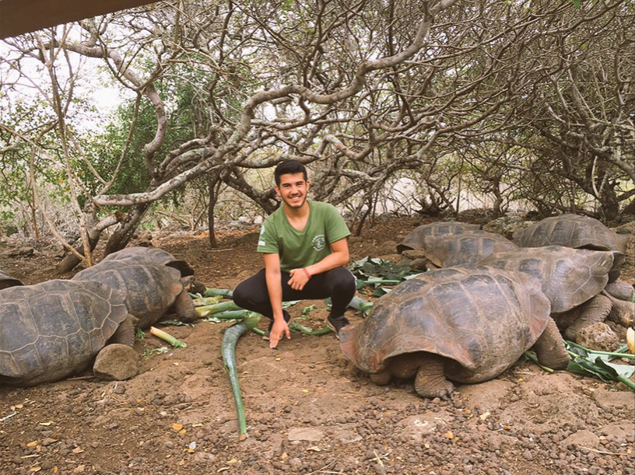
Live Your Dream
2023
IST Assembly October ‘22 www.jamesraodream.com

Slide 2
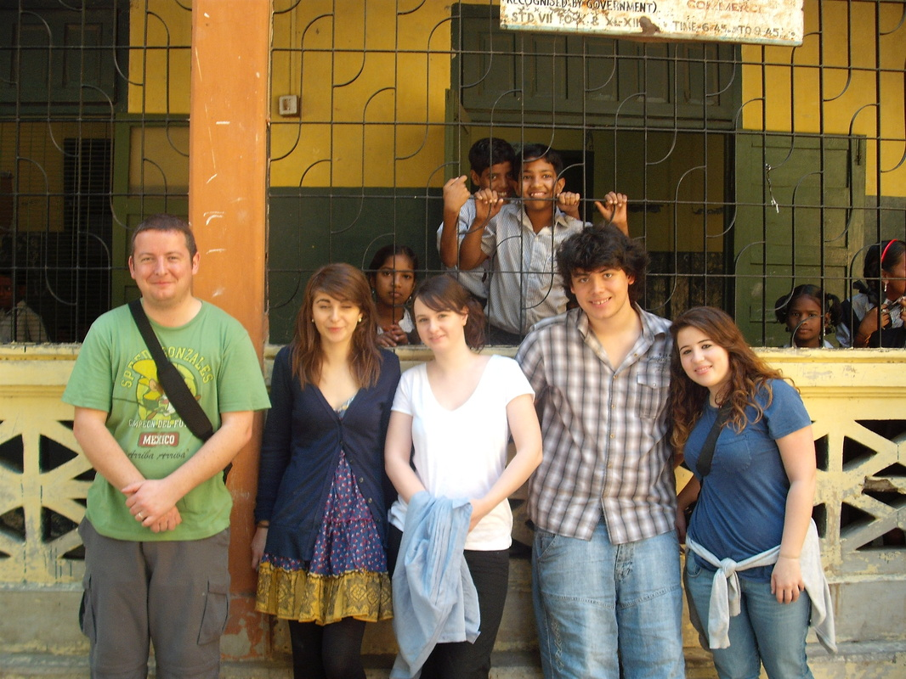
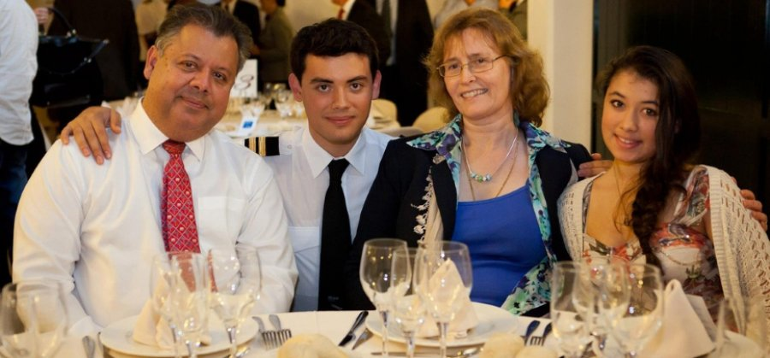
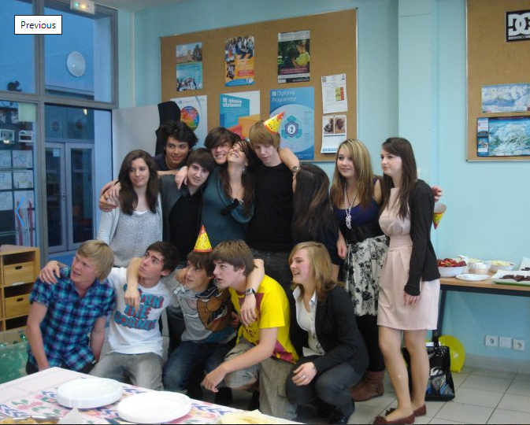
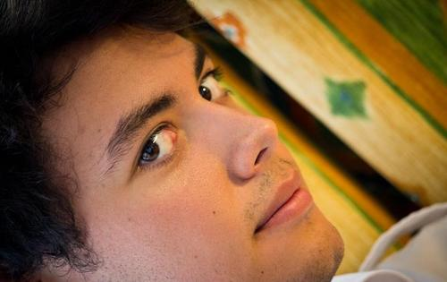
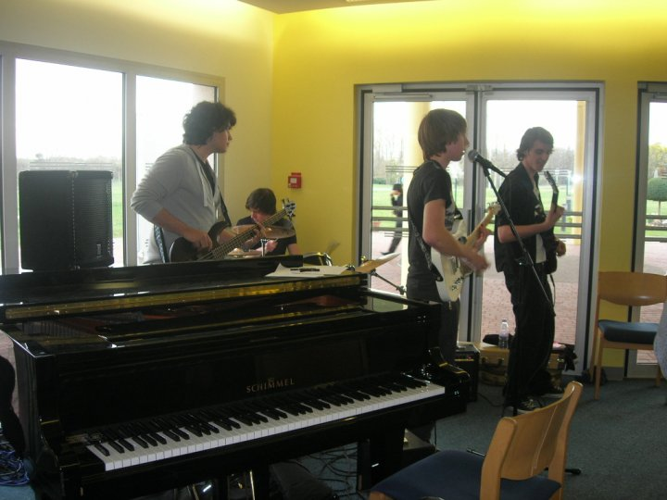

Slide 3
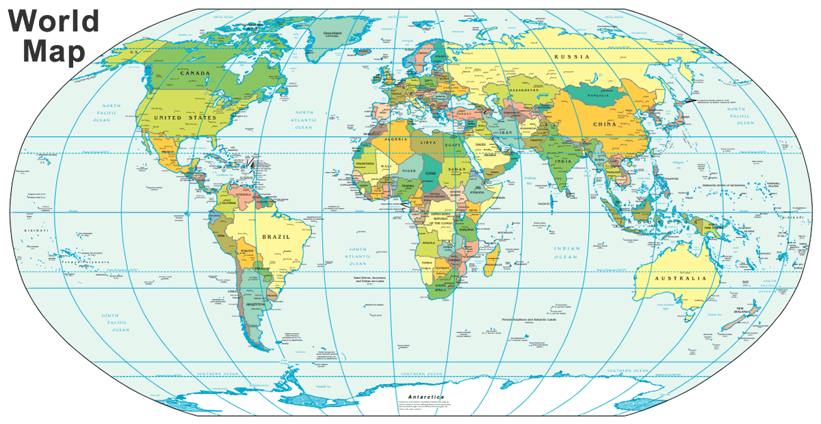
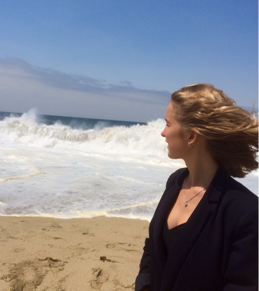
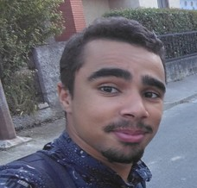
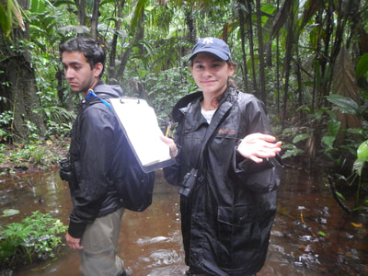
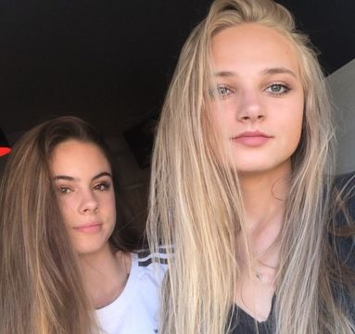
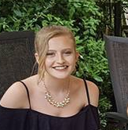
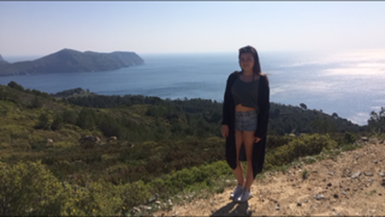
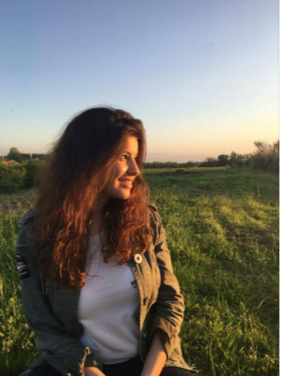
Where have LYD adventurers been?

Slide 4
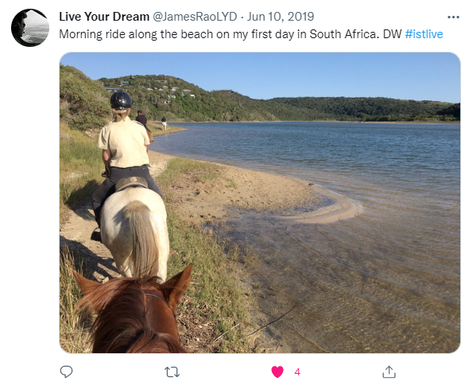
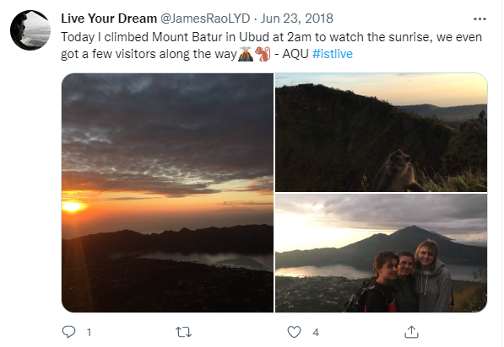
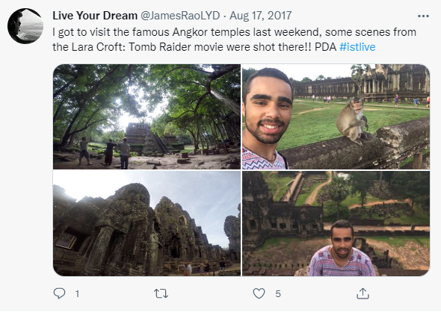
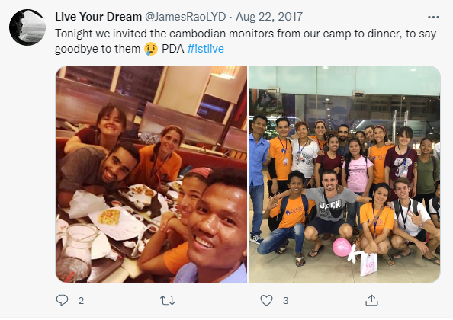
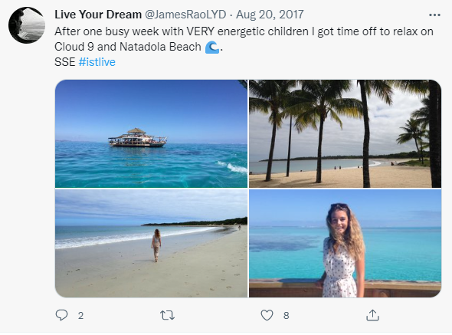
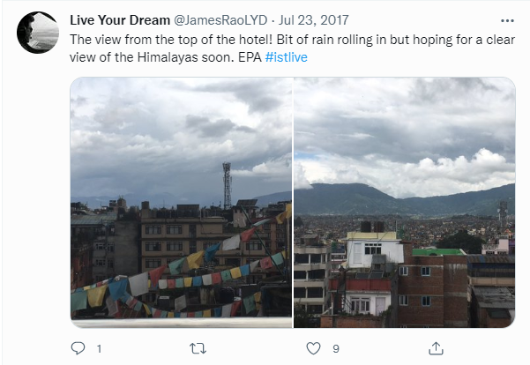

Slide 5
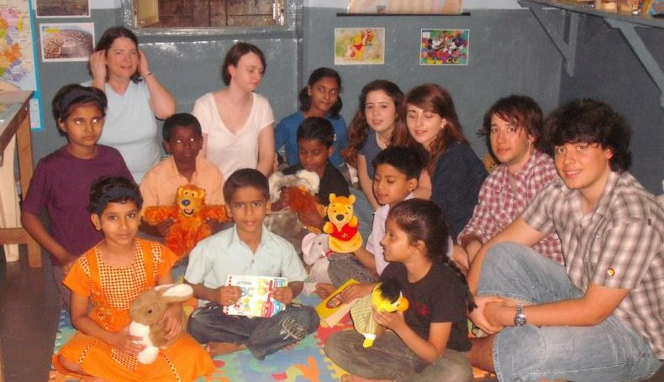
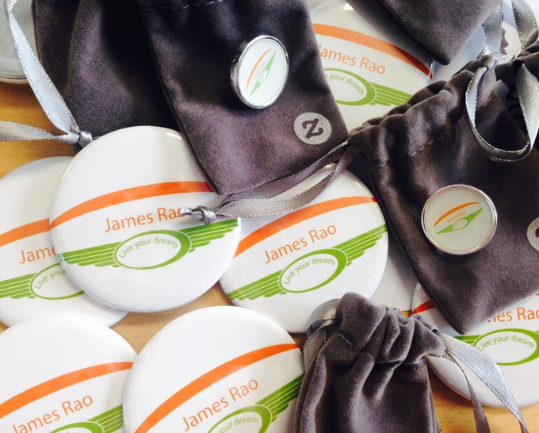
Apply for up to €4000 per person for your dream trip from the ‘Live Your Dream’ Foundation. Individual application or group application

Slide 6
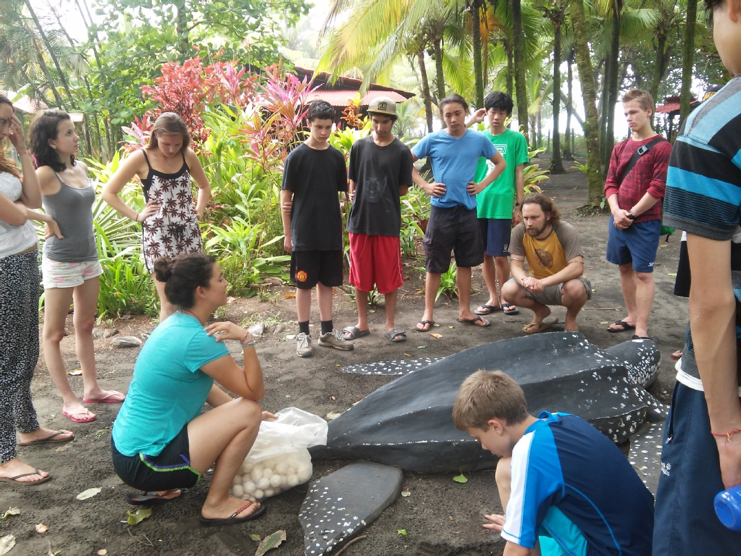
Living Your Dream Responsibly

Slide 8
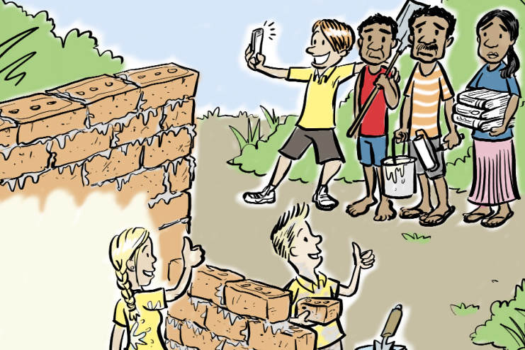
‘Voluntourism’

Slide 9
In an age of ‘voluntourism’ ….

Slide 11
Advice when choosing an overseas project.
Do you want to add professional skills to your CV, have a new cultural experience, make new friends or be a part of long term change in a community?
When choosing an organisation to travel away with, what is it’s mission and what causes does it support?
Stay away from orphanages. Orphanages are the number one ‘voluntourism’ trap.
If you want to work with children, study the opportunities carefully. You should try to imagine a similar situation in your own country. Would a school near you allow any person to teach, interact or be alone with children? Unlikely. The same applies for volunteering abroad with children – the stricter the requirements are for volunteers, the more likely the organisation operates ethically.
Beware of exploitative animal sanctuaries. What are the goals of the organisation? What are their handling policies? Is it managed by professionals?

Slide 12
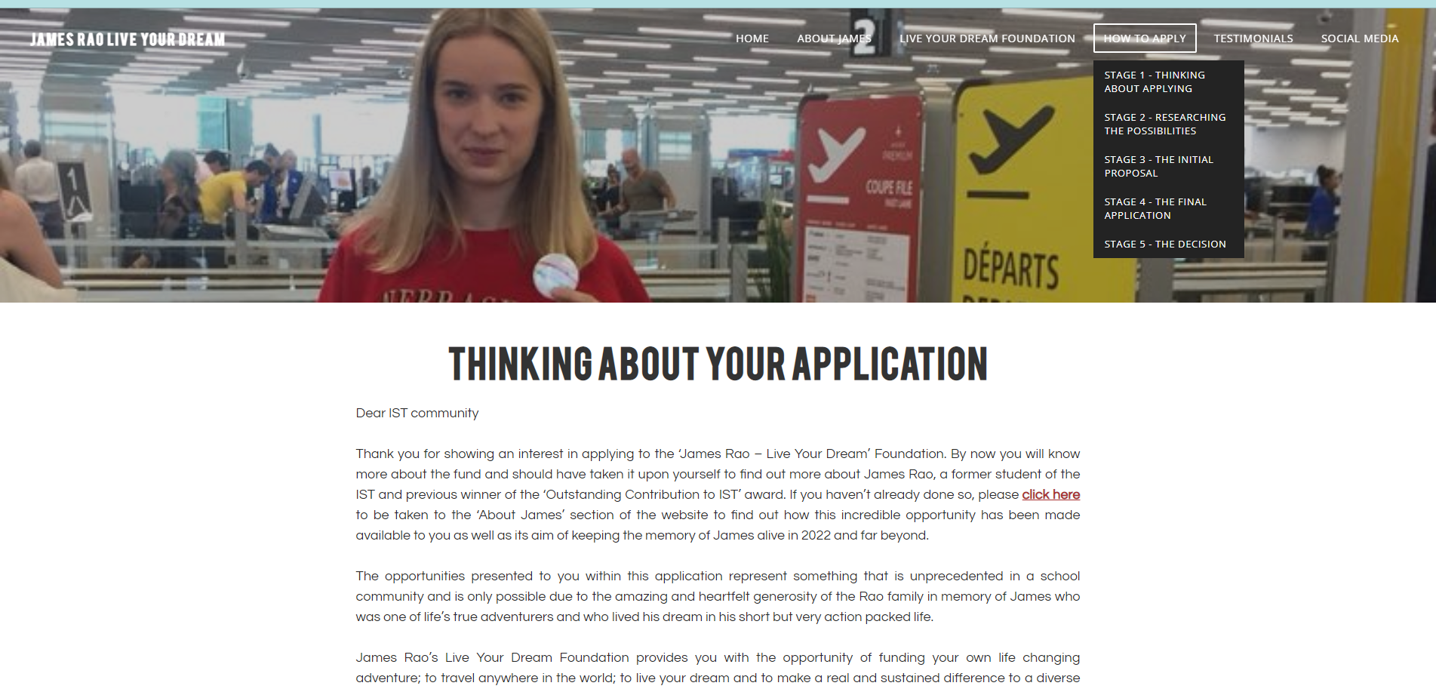

Slide 13
Deadlines 2022: Initial Application – Friday 11th November 2022 Final Application – Friday 25th November 2022 Successful applicants will be informed before the Christmas holiday.

Slide 14
Check this out….

